Slide 1
What is Intelligence?
Intelligence is the ability to understand and learn things. - Essential English Dcitionary.
“Intelligence is the capacity to act purposefully with the environment” - David Weshlar
“Intelligence is the general mental adaptibility to new problems and conditions” - W. Stern
Learning? - Any relatively permanent change in behavior which occurs as a result of experience or practice.

Slide 2
What is Artificial Intelligence?
AI is a branch of Computer Science concerned with the study and creation of computer systems that exhibit some form of intelligence
Learn new concepts
Reason and draw useful conclusions about the world
Understand a natural language or perceive and comprehend a visual scene
Perform other types of feats that require human types of intelligence
Goal of AI:
make machines do things that would require intelligence if done by humans.
Understand principles of human intelligence

Slide 3

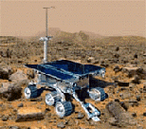

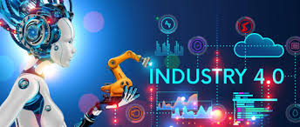
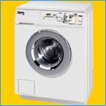
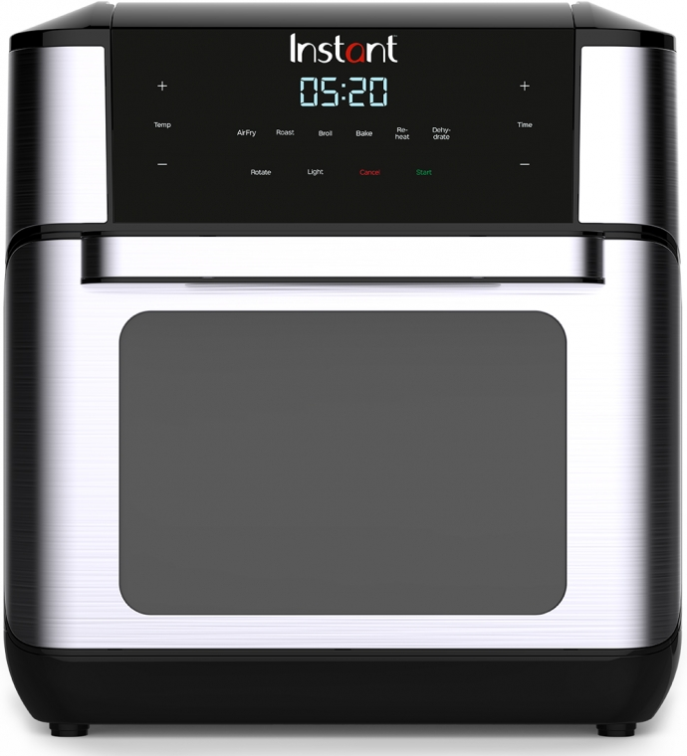
Why study AI?
Search engines
Medicine/
Diagnosis
Science
Appliances
Labor
What else?

Slide 4
What is Artificial Intelligence?
AI is Discipline that systematizes and automates intellectual tasks to create machines to
Act like humans | Act rationally
Think like humans | Think rationally

Slide 5
Act Like Humans
The goal of AI is to create computer systems that perform functions that are assumed to require intelligence when done by humans
→ Methodology:
Take a task at which people are better, e.g.:
  Prove a theorem
  Play chess
  Plan a surgical operation
  Diagnose a disease
  Navigate in a building
and make a computer do it

Slide 6
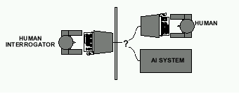
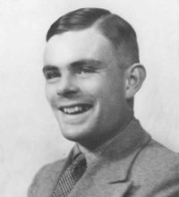
Act Like Humans- Intelligent Machine(Turing Test)
Alan Turing's 1950 article Computing Machinery and Intelligence discussed conditions for considering a machine to be intelligent
-“Can machines think?” ←→ “Can machines behave intelligently?”
-The Turing test (The Imitation Game): Operational definition of intelligence. Can a computer convince a human interrogator that it is a human?
Computer needs to posses: Natural language processing, Knowledge representation, Automated reasoning, and Machine learning
Are there any problems/limitations to the Turing Test?
Alan Turing

Slide 7
Think Like Humans
How the computer performs functions does matter
Comparison of the traces of the reasoning steps (cognitive science)
But, do we want to duplicate human imperfections?
Role of explicit symbolic knowledge
(lemmas, concepts, …)
Pattern recognition → Neural nets
Still a research topic: from signals to symbols

Slide 8
Think/Act Rationally
Always make the “best” decision given what is available (knowledge, time, resources)
“best” → maximizes the expected value of a utility function (≠ perfection)
Strong ties to economics (e.g., game theory), probabilistic modeling, and control theory
But, to some extent, the role of consciousness, emotions, or fear of dying on intelligence is ignored

Slide 9
AI Prehistory(Academic Disciplines important to AI.)
Philosophy: Logic, methods of reasoning, mind as physical
system foundations of learning, language,
rationality
Mathematics: Formal representation and proof algorithms,
computation, (un)decidability, (in)tractability,
probability
Economics: Utility, decision theory
Neuroscience: Physical substrate for mental activity
Psychology: Phenomena of perception and motor control,
experimental techniques
Computer: Building fast computers
engineering
Control theory: Design systems that maximize an objective
function over time
Linguistics: Knowledge representation, grammar

Slide 10
AI History
The Dark Ages [ The birth of A.I.]: Duration: 1943-56
  Contributions: First work by Warren McCulloch & Walter Pitts [ 1943 ]. It was on the central nervous system-a model of neurons of the brain.
  Turing, Computing Machinery & intelligence, 1950
  ENIAC (Electronic Numerical Integrator And Calculator) by Von Neumann.
  Shannon, Programming a computer for playing chess, 1950.
  The Dartmouth College summer workshop on machine intelligence, Artificial neural networks and automata theory, 1956

Slide 11
AI History
Rises of A.I: Duration: 1956-late 1960s
Contributions:
  John McCarthy (inventor of the term Artificial Intelligence) defined the high level language LISP – one of the oldest programming language, which is still in current use.
  General Problem Solver (GPS) by Newell & Simon, 1960
  Human Problem Solving ideas by Newell & Simon, 1972
  A framework for representing knowledge by Minsky, 1975

Slide 12
AI History
The Rebirth of Artificial Neural Networks: 1965 – onward
Contributions:
  Neural Networks & Physical Systems with Emergent Collective Computational Abilities by Hopfield.
  Self-Organized Formation of Topological Correct Feature maps by Kohonen
  Parallel Distributed Processing, by Rumelhart & McClelland
  The First IEEE International Conference on Neural Networks.

Slide 13
AI History
The Era of unfulfilled promises [ The impact of reality]
Duration: late1960s-early 1970s
Contributions:
  The Complexity of theorem proving procedures by Cook, 1971
  Reducibility Among Combinatorial Problems by Karp 1972

Slide 14
AI History
Evolutionary computation [Learning by doing]
Duration: early 1970s – onward
Contributions:
  Adaptation in Natural and Artificial Systems, by Holland
  Genetic Programming: On the Programming of the computers by means of Natural Selection by Koza
  Evolutionary computation – Towards a new philosophy of machine intelligence by Fogel

Slide 15
AI History
The Discovery of expert systems
Duration: 1970s – mid 1980s
Contributions:
  DENDRAL – the first successful knowledge-based system by Feigenbum, Bachanan & Lederberg.
  MYCIN – another expert system by Feigenbum and Shortllife
  PROSPECTOR – an expert system for mineral exploration developed by Stanford Research Institute
  PROLOG – A logic programming language by Colmerauer, Roussel & Kowalski
  EMYCIN – Empty MYCIN, a domain-independent version of MYCIN, developed by Stanford University.

Slide 16
AI History
Computing with Words: late 1980s – onwards
Contributions:
  Fuzzy sets & Algorithms by Zadeh
  Application of Fuzzy logic to Approximate Reasoning using Linguistic Synthesis by Mamdani
  Expert Systems and Fuzzy Systems, by Negoita.
  The First IEEE International Conference on Fuzzy Systems
  Neural Networks and Fuzzy Systems by Kosko
  Fuzzy Logic, MATLAB Application Toolbox by the MathWork, Inc.)

Slide 17
AI applications
Autonomous planning and scheduling of tasks aboard a spacecraft, in autonomous rovers, Telescope scheduling, Analysis of data
Beating Gary Kasparov in a chess match
Steering a driver-less car
Understanding language
Monitoring trade in the stock market to see if insider trading is going on
Medicine: Image guided surgery, Robotic assistants in surgery Image analysis and enhancement
Transportation: Autonomous vehicle control, Pedestrian detection

Slide 18
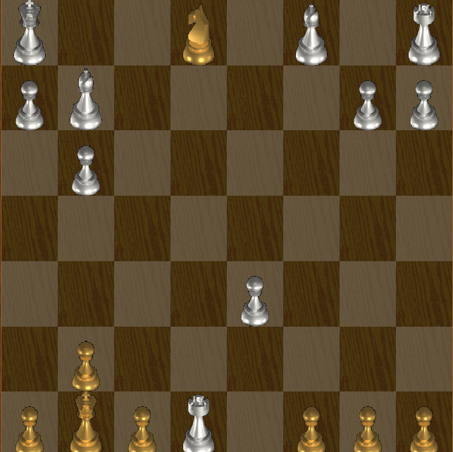
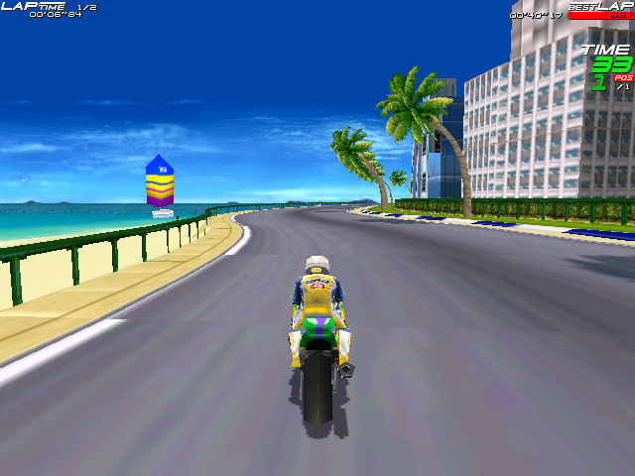
AI applications
Games:
Robotic toys:

Slide 19
AI applications
Other application areas:
Bioinformatics:
Gene expression data analysis
Prediction of protein structure
Biometric Identification
  walk up to a locked door
    fingerprint device
Text classification, document sorting:
Web pages, e-mails
Articles in the news
Video, image classification
Music composition, picture drawing
Natural Language Processing.
Perception.

Slide 20
AI applications
Other application areas:
Speech synthesis, recognition and understanding
  very useful for limited vocabulary applications
  unconstrained speech understanding is still too hard
Computer vision
  works for constrained problems (hand-written zip-codes)
  understanding real-world, natural scenes is still too hard

Slide 21
AI applications
Other application areas:
Speech synthesis, recognition and understanding
  very useful for limited vocabulary applications
  unconstrained speech understanding is still too hard
Computer vision
  works for constrained problems (hand-written zip-codes)
  understanding real-world, natural scenes is still too hard
Learning
  adaptive systems are used in many applications: have their limits
Post Office
  automatic address recognition and sorting of mail
Banks
  automatic check readers, signature verification systems
  automated loan application classification
Telephone Companies
  automatic voice recognition for directory inquiries
  automatic fraud detection,
  classification of phone numbers into groups
Credit Card Companies
  automated fraud detection, automated screening of applications
ID cards
  e.g., ATM cards
  can be a nuisance and security risk:
    cards can be lost, stolen, passwords forgotten, etc.

Slide 22
AI applications
Other application areas:
Speech synthesis, recognition and understanding
  very useful for limited vocabulary applications
  unconstrained speech understanding is still too hard
Computer vision
  works for constrained problems (hand-written zip-codes)
  understanding real-world, natural scenes is still too hard

Slide 23
AI applications
Other application areas:
Learning
  adaptive systems are used in many applications: have their limits
Post Office
  automatic address recognition and sorting of mail
Banks
  automatic check readers, signature verification systems
  automated loan application classification

Slide 24
AI applications
Other application areas:
Telephone Companies
  automatic voice recognition for directory inquiries
  automatic fraud detection,
  classification of phone numbers into groups
Credit Card Companies
  automated fraud detection, automated screening of applications
ID cards
  e.g., ATM cards
  can be a nuisance and security risk:
    cards can be lost, stolen, passwords forgotten, etc.

Slide 25
Some advantages of AI
More powerful and more useful computers
new and improved interfaces
solving new problems
better handling of information
relieves information overload
conversion of information into knowledge

Slide 26
The disdvantages
increased costs
difficulty with software development - slow and expensive
few experienced programmers
few practical products have reached the market as yet.

Slide 27
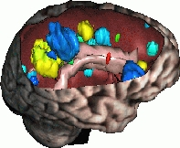
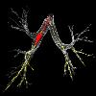

Predictions and Reality … (1/3)
In the 60’s, a famous AI professor from MIT said: “At the end of the summer, we will have developed an electronic eye”
As of 2004, there is still no general computer vision system capable of understanding complex dynamic scenes
But computer systems routinely perform road traffic monitoring, facial recognition, medical image analysis, part inspection, motion capture, …

Slide 28
Predictions and Reality … (2/3)
In 1958, Herbert Simon (CMU) predicted that within 10 years a computer would be Chess champion
This prediction became true in 1997.
Today, computers have won over world champions in several games, including Checkers, Othello, and Chess, but still do not do well in Go
AI techniques (search, planning, probabilistic reasoning) are used in many video games

Slide 29
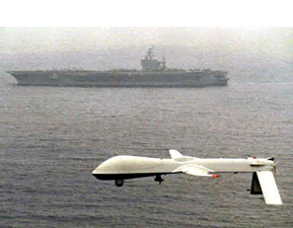
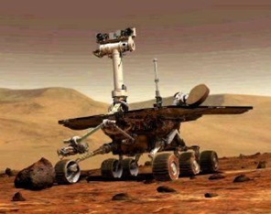
Predictions and Reality … (3/3)
In the 70’s, many believed that computer-controlled robots would soon be everywhere from manufacturing plants to home
Today, some industries (automobile, electronics) are highly robotized, but home robots are still a thing of the future
But robots have rolled (are rolling) on Mars, fly autonomously

Slide 30
AI – The Achievements
Robots make cars in all advanced countries.
Reasonable machine translation is available for a large range of foreign web pages.
Computers land 200 ton jumbo jets unaided every few minutes.
Search systems like Google are not perfect but provide very effective information retrieval
Robots cut slots for hip joints better than surgeons.
Medical expert systems can outperform doctors in many areas of diagnosis.

Slide 31
AI – The Achievements
Deep Blue defeated the reigning world chess champion Garry Kasparov in 1997.
No hands across America (driving autonomously 98% of the time from Pittsburgh to San Diego).
During the 1991 Gulf War, US forces deployed an AI logistics planning and scheduling program that involved up to 50,000 vehicles, cargo, and people.
NASA's on-board autonomous planning program controlled the scheduling of operations for a spacecraft.
Solves crossword puzzles better than most humans.

Slide 32
AI – A Comment
Despite all these achievements, one of the major philosophers of Cognitive Science wrote recently:
“… the failure of artificial intelligence to produce successful simulation of routine commonsense cognitive competences is notorious, not to say scandalous. We still don't have the fabled machine that can make breakfast without burning down the house; or the one that can translate everyday English into everyday Italian, or the one that can summarize texts..” (Jerry Fodor, The Mind doesn’t Work that Way, 2000, p.37).

Slide 33
AI Trend
Early AI concentrated on building intelligent machines that mimicked human behavior.
Present AI devoted to embedding AI algorithms and techniques (neural networks, genetic algorithms, fuzzy logic, and intelligent agents) into software to provide them with the ability to learn, optimize, and reason.

Slide 34
Recommended Textbooks
[Negnevitsky, 2001] M. Negnevitsky “ Artificial Intelligence: A guide to Intelligent Systems”, Pearson Education Limited, England, 2002.
[Russel, 2003] S. Russell and P. Norvig Artificial Intelligence: A Modern Approach Prentice Hall, 2003, Second Edition
[Patterson, 1990] D. W. Patterson, “Introduction to Artificial Intelligence and Expert Systems”, Prentice-Hall Inc., Englewood Cliffs, N.J, USA, 1990.
[Minsky, 1974] M. Minsky “A Framework for Representing Knowledge”, MIT-AI Laboratory Memo 306, 1974.
[Hubel, 1995] David H. Hubel, “Eye, Brain, and Vision”
[Ballard, 1982] D. H. Ballard and C. M. Brown, “Computer Vision”, Prentice Hall, 1982

